Slide 1




Mühlberg Jan Tobias
Mühlberg Jan Tobias
Threat Modeling and security assessment of a NAS storage system in a small office network
Messaoudi Leila
Supervisors : Pr.MJ Tobias, Navid Ladner
ELEC-H550 Embedded System Security
16 December 2025

Slide 2


Summary
Scope
Scope and methodology
DFD
STRIDE
Nmap and Nessus
Matrice of impact
Mitigations
Messaoudi Leila

Slide 3
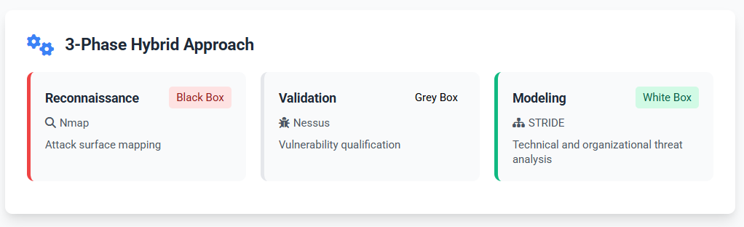
Scope and Methodology
Messaoudi Leila

Slide 4
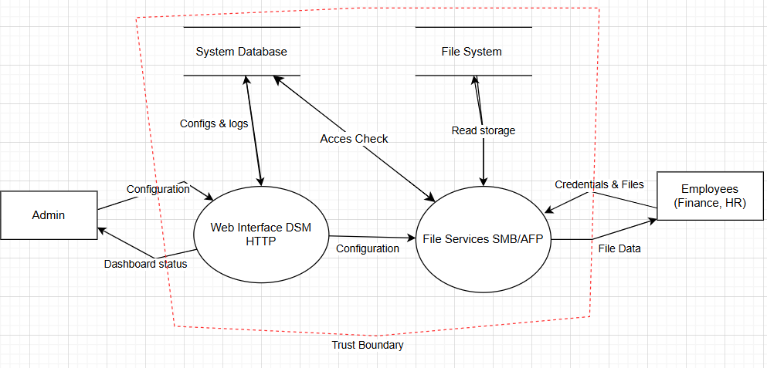
DFD
Messaoudi Leila

Slide 5
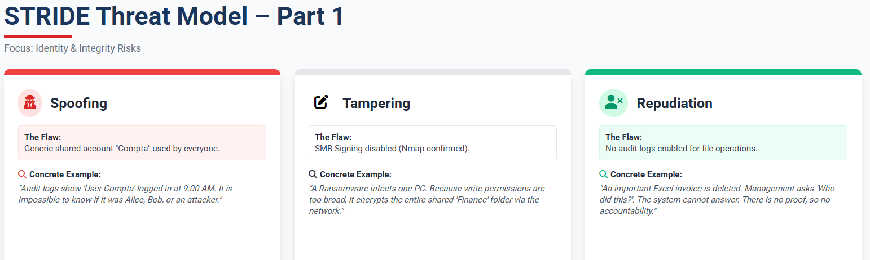
Messaoudi Leila

Slide 6
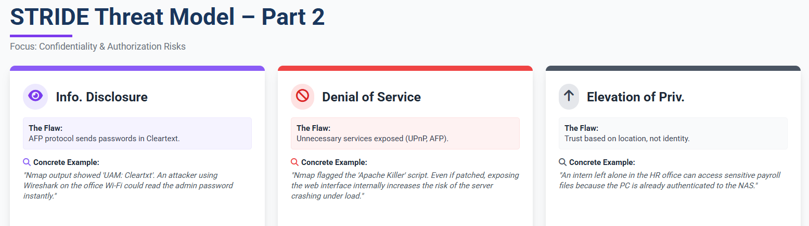
Messaoudi Leila

Slide 7
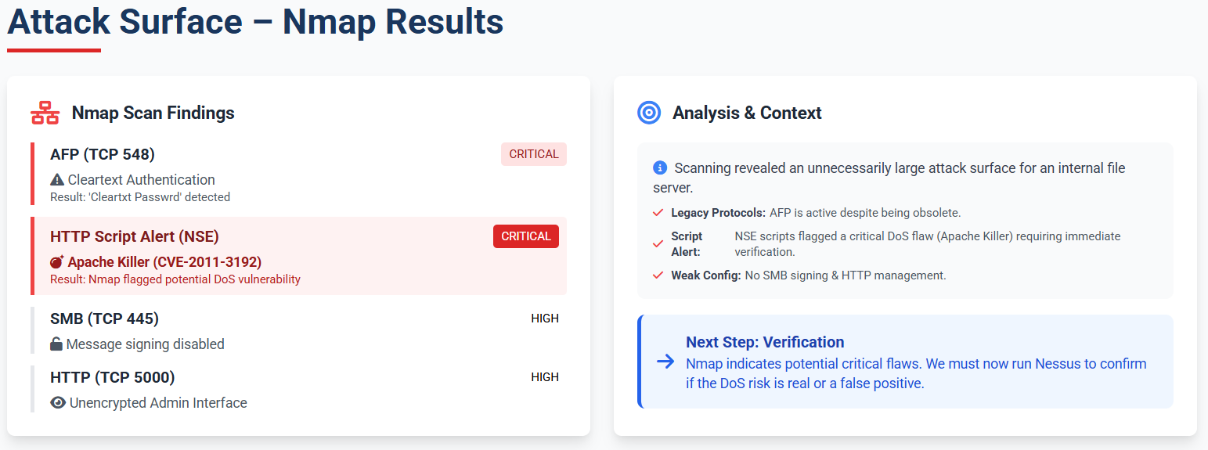
Scan Nmap
Messaoudi Leila

Slide 8
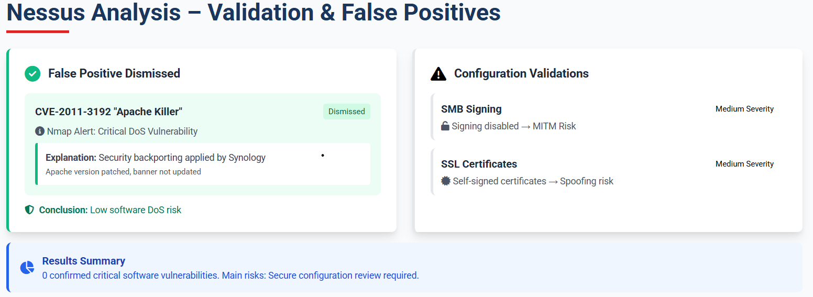
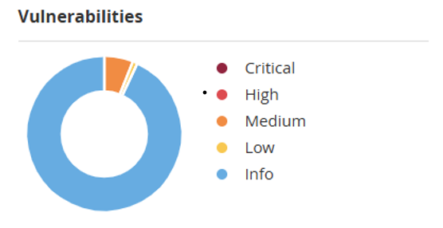
Scan Nessus
Messaoudi Leila

Slide 9
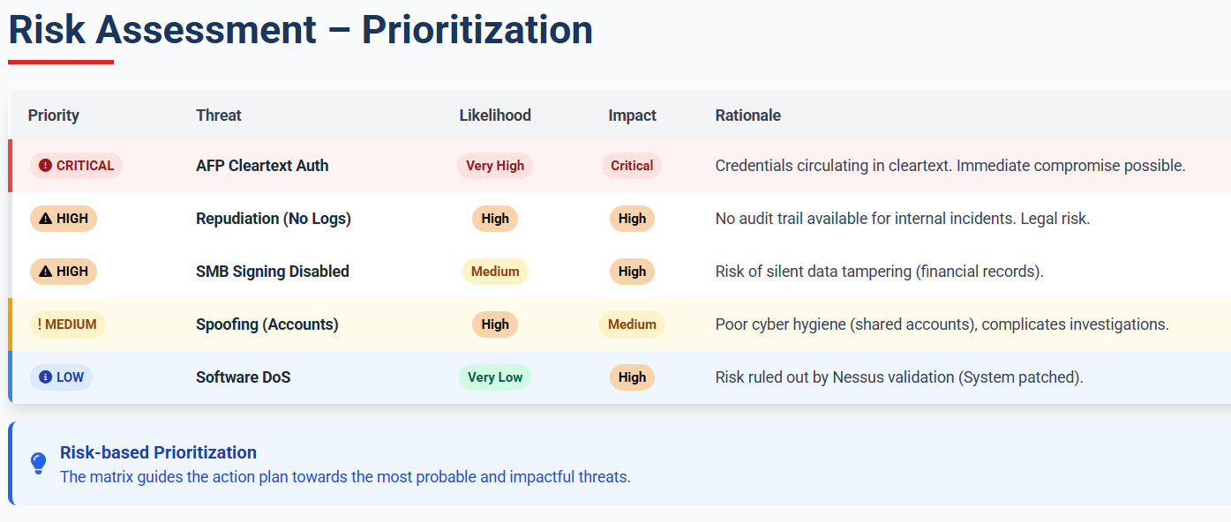
Messaoudi Leila

Slide 10
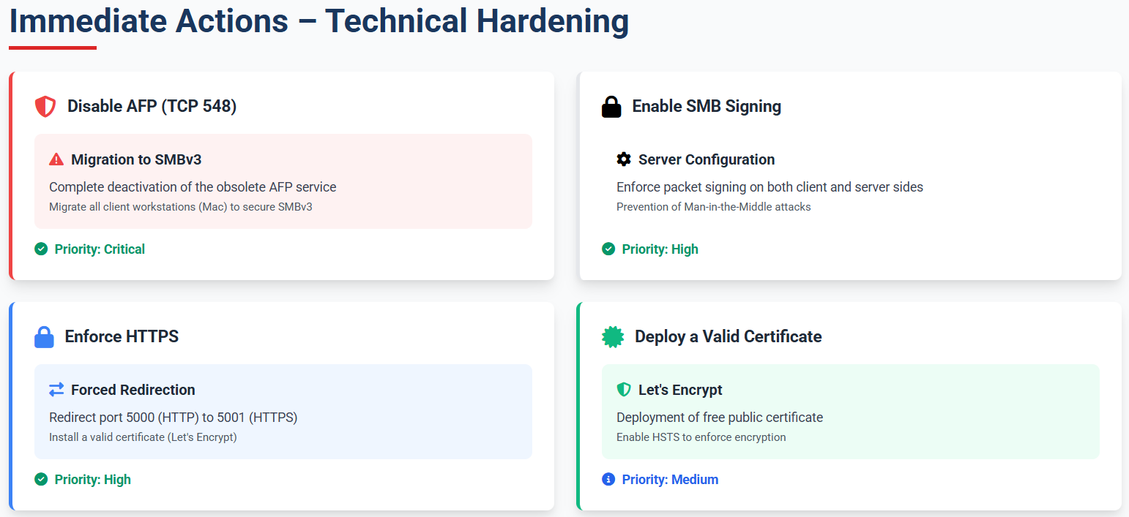
Mitigations
Messaoudi Leila

Slide 11
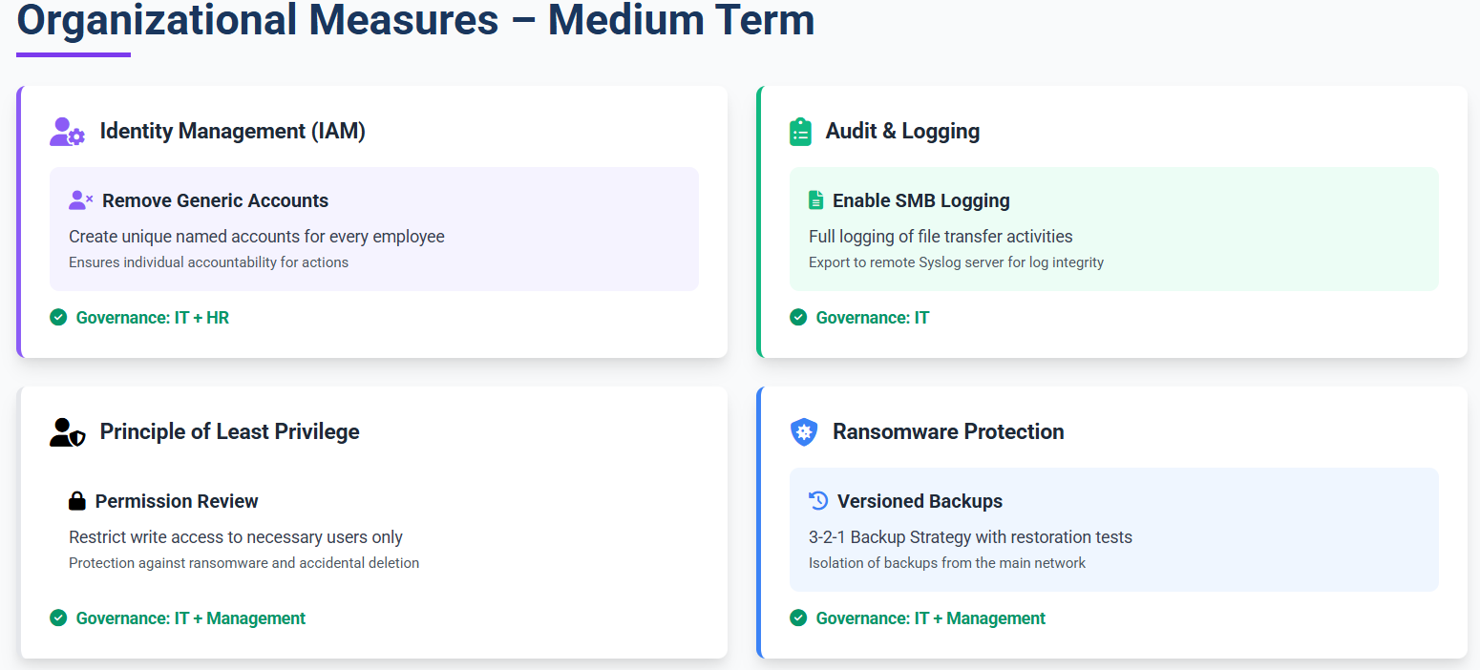
Mitigations
Messaoudi Leila

Slide 12
Thank You!
Messaoudi Leila

Slide 13
Questions ?
Messaoudi Leila

